Slide 1

Federal Urdu University of Arts Commerce Science and Technology
Smart Transaction Sorter & Analytics System
PRESENTED BY
PRESENTED TO
Mahhin Shahzad
Mr.Muhammad Aqib Rauf

Slide 2
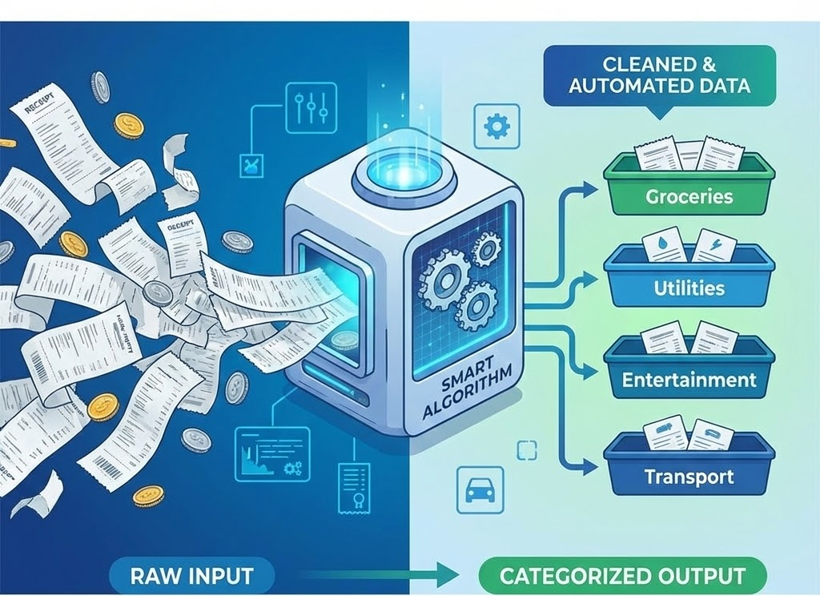
1.Introduction
The Data Problem
Digital wallets like Easypaisa and Sadapay provide access to transaction history, but usually in raw, messy CSV formats. Users are left drowning in unorganized data.
Our Vision
To build the missing intelligence layer for Pakistan's digital ecosystem. We take over where local wallets stop, using Automation and AI to turn their raw data exports into a powerful, automated personal finance dashboard.
Figure 1: Operational Concept of the Smart Transaction Sorter

Slide 3
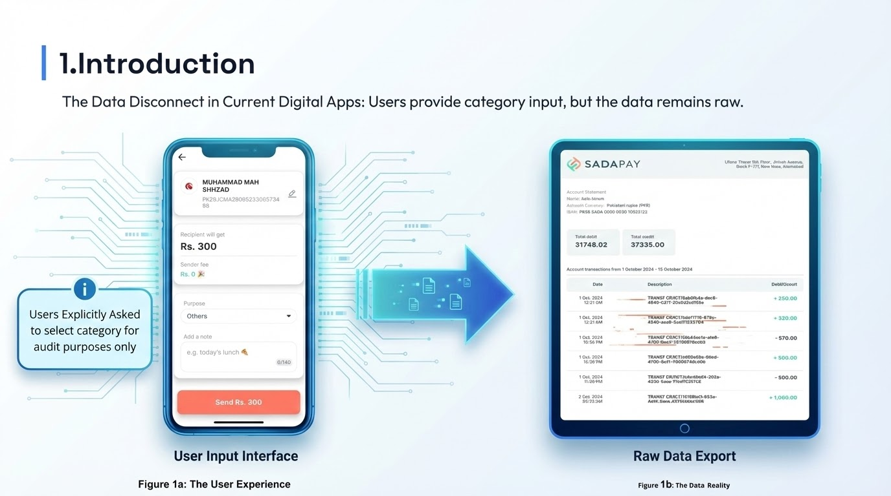

Slide 4
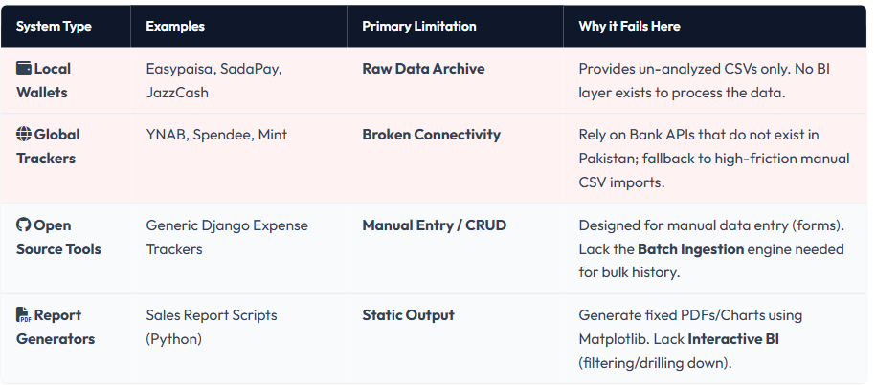
2.Literature Review & Gap Analysis
Evaluation Metric | Local Digital Wallets (Easypaisa / SadaPay) | Global Expense Trackers (YNAB / Spendee)
Data Integration | Raw export only; provides unconnected CSV files. | Broken connectivity; rely on bank APIs that don’t work in Pakistan.
Sorting Logic | Non-existent; only logs the transaction, no analytics. | Rigid / rule-based; uses generic keywords and fails at context.
Workflow | Manual processing; user must move data to Excel manually. | High friction; even where CSV import is supported, users still need to remap fields and clean data before & after every import.
Adaptability | N/A | Fixed Cannot sort transactions into new, user-created categories.

Slide 5
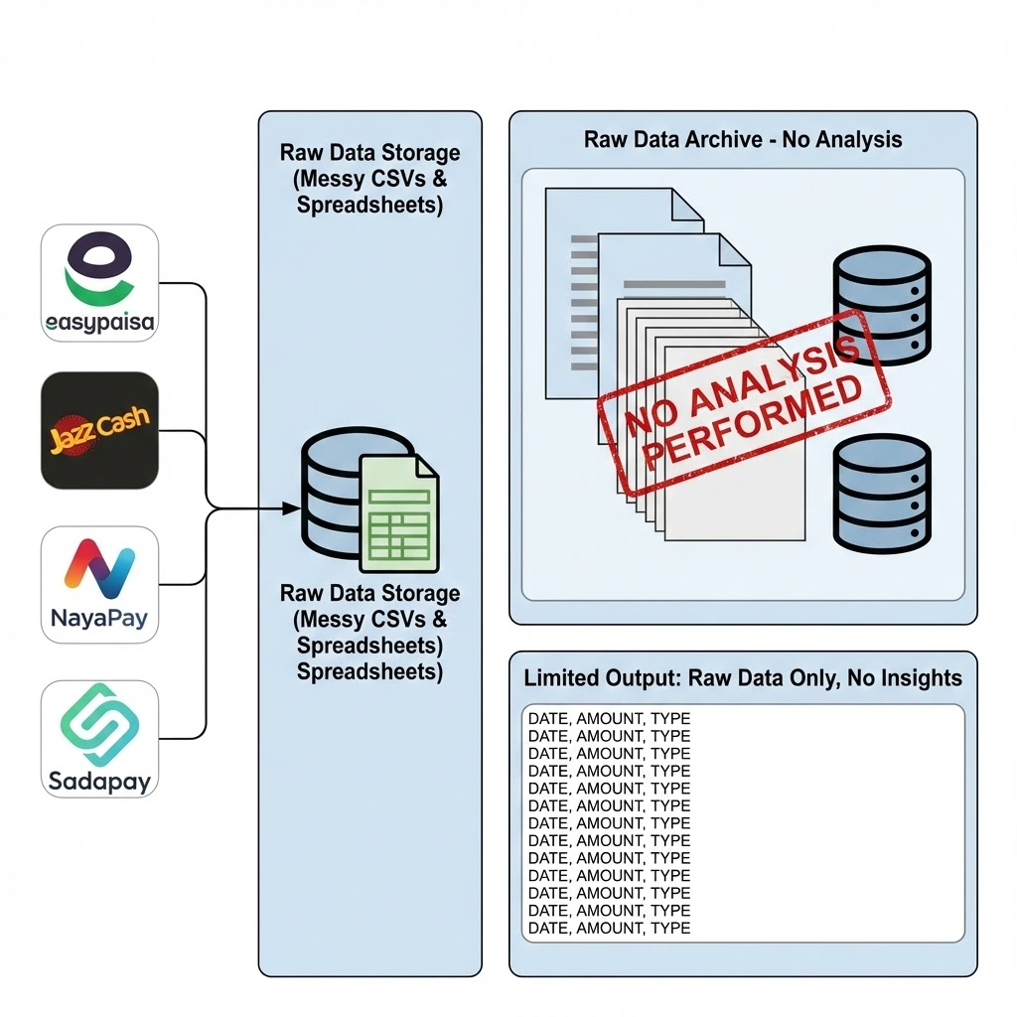


3.Problem Statement
Payments Work, Insights Don't
Current Challenges:
No Built-in BI: Local wallets (JazzCash, Naya Pay) excel at payments but fail at providing meaningful analytics.
Manual Work: The current workflow requires exporting data, cleaning it in Excel, and manually tagging hundreds of rows.
Impact: This process is time-consuming, prone to human error, and static (no real-time insights).
Figure 2: Existing flow of wallet data – raw files only, no insight layer.

Slide 6






4.Proposed Solution: An Integrated Pipeline
Backend Logic
Intelligent Sorting
Visualization
Python Django framework for robust data handling and secure API endpoints.
NLP for context-aware classification of transaction descriptions.
Interactive Power BI Dashboard integration for dynamic reporting.

Slide 7
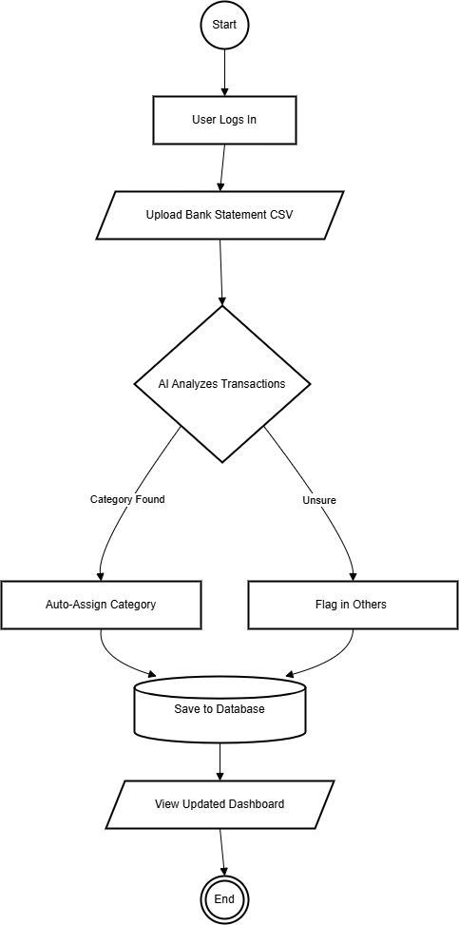
5.System Methodology
A standalone web application that automates the entire lifecycle of transaction data from raw CSV to polished dashboard.
Step 1: User uploads Raw Data.
Step 2: System processes & classifies.
Step 3: Clean data is piped to BI.
The System will be developed using Agile Methodologies incrementally With multiple Sprints .
Figure 3 : WorkFlow Diagram of System

Slide 8





6.System Architecture Modules
1. Ingestion Module
2. Logic Module
3. BI Module
Secure CSV intake form, validation of columns (Date, Amount), and parsing via Pandas.
Pre-processing strings, Classification Engine (mapping keywords), and Confidence Checks.
Aggregation of totals, rendering via Power BI, and interactive date/category filters.

Slide 9
7.Results & Performance
Metric | The Challenge (Manual/Old) | Our Technical Solution | Measured Result
Processing Speed | Manual Entry Takes ≈ 45 mins to classify 500 txns. | Automated Parsing Using Python Pandas & Django. | < 60 Seconds To process & sort 500 rows.
Classification Accuracy | Variable Prone to human fatigue & error. | AI Classification Using Hugging Face Zero-Shot. | 80 % Accuracy On validation datasets.
Data Security | High Risk Cloud apps sell or leak data. | Isolated Database Secure, private architecture. | No Third-Party Sharing Data never leaves the system.
Insights Quality | Static Rows Hard to see trends in CSV. | BI Integration Interactive Dashboarding. | Dynamic Analysis Filter by date & category instantly.

Slide 10

Conclusion
"
"We have successfully bridged the gap between raw data and personal financial intelligence & Awareness in local market of Pakistan . "
Key Takeaway: Automation reduces expense management time by 60-70% while significantly increasing insight accuracy.

Slide 11
References & Data Sources
Market Gap Validation
Technical Solution & Data
[1] SadaPay Help Center. "Account Statement Guide: Exporting CSVs." [Available: help.sadapay.pk]
[6] Django Software Foundation. "Django 5.0 Documentation: Views & File Uploads." [Available: docs.djangoproject.com]
[2] NayaPay Support. "Viewing Documents & Transaction History." [Available: help.nayapay.com]
[7] EntrepreneurLife. "Personal Finance: Real-World Transactions Dataset." [Available: kaggle.com/datasets/personal-finance]
[3] Easypaisa. "Schedule of Charges & Features." [Available: easypaisa.com.pk/faqs]
[8] Hugging Face. "Zero-Shot Classification Pipeline." [Available: huggingface.co/docs]
[4] JazzCash. "Feature Update: Spending Tracker Announcement." [Available: JazzCash Official Video]
[9] Microsoft. "Embed Content in an Application (Power BI)." [Available: learn.microsoft.com]
[5] YNAB Support. "File-Based Import: A Guide for Non-US Banks." [Available: support.ynab.com]
[10] R. Shah. "Income-Expense Tracker (Django Open Source)."
[ https://github.com/rishank-shah/Income-Expense-Tracker]
[11] H. Patel. "Sales-Report-Generator (Python Script)." [https://github.com/hita03/Sales-Report-Generator]

Slide 12

References
[1] SadaPay Help Center. "Account Statement: How to view your transaction history," SadaPay Official Knowledge Base.
[2] NayaPay Support. "How can I view my documents on NayaPay?" NayaPay Help Center.
[3] JazzCash. "Spending Tracker Feature Announcement," JazzCash Official Media, 2025.
[4] YNAB (You Need A Budget). "File-Based Import: A Guide for Non-US Banks," YNAB Support.
[5] EntrepreneurLife. "Personal Finance: Real-World Transactions Dataset (2018-2019)," Kaggle Open Data Repository.
Technical Libraries
Django 5.0 (Web Framework)
Pandas ("Data Analysis with Python")
Microsoft Power BI Developer Docs

Slide 13
Thank You!
Questions ?

